Slide 1
Sales Predictions for Outlets
Item Sales from 1985-2009
By: Janaea B - Data Science Student

Slide 2
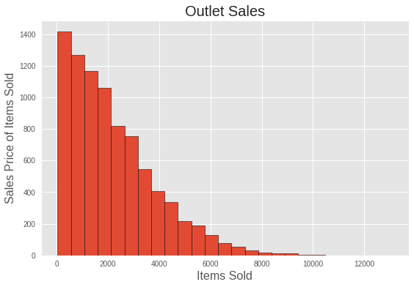
Key Points
As to be expected, lower and mid-range priced items sell in higher quantities
The largest percentage of Items sold are consumable
Food = 72%
Beverages = 9%
Non-Consumables = 22%
Notes:
97% of the items sold in our dataset averaged less than half the price of the most expensive item listed.

Slide 3
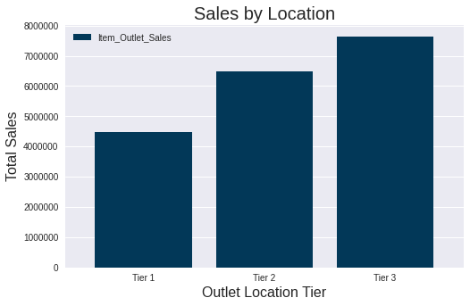
Key Points
Tier 1 =
28% of Outlet Sales
Medium, Small sq/ft stores
2 Supermarket Type 1 (1 Med & 1 Small)
1 Grocery Store (Small)
Tier 2 =
33% of Outlet Sales
Small, Unspecified sq/ft stores
2 Supermarket Type 1 (2 UnSp & 1 Small)
Tier 3 =
39% of Outlet Sales
Small, Medium and High sq/ft stores
1 Supermarket Type 1 (1 High)
1 Supermarket Type 2 (1 Med)
1 Supermarket Type 3 (1 Med)
1 Grocery Store (Unsp - Most likely Small)
Notes:
Tier 3 Outlet locations make up the lion’s share of the sales for this dataset, however 40% of the stores are located within this area
Outlet stores in the Tier 2 locations average 11% of the total sales picture equaling 33%
And Tier 1 makes up the remaining 28% between 3 stores, meaning that each store in the tier 1 locations average almost 9.5%

Slide 4
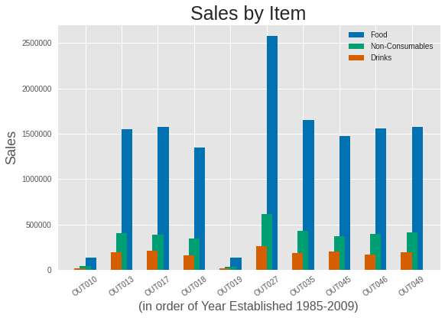
Notes:
Outlet 27 is a Type 3 Supermarket in the Tier 3 Location category. It by far accounts for much of the Tier 3 Location Outlet Sales. And interestingly the store with the lowest sales numbers is also in the the same location tier as Outlet 27. Another interesting fact about Outlet 27 is that the store is of medium square footage and therefore must be strategically located near heavier traffic with higher priced items across the board.

Slide 5
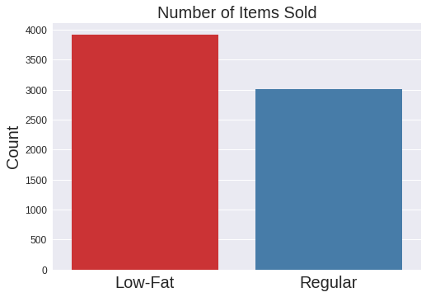
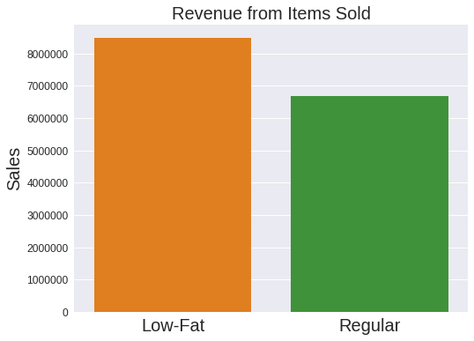
Fat Content of Consumable Foods
Notes:
Because Consumable Items make up such a large portion of our sales data, examining the fat content shines a light on the types of food and beverages customers are purchasing, On the left you can see that Low-Fat items make up 57% of the total consumable items sold and the right image makes it clear that revenues are consistent with the higher amount of items sold. Low-Fat foods and beverages are responsible for 56% of total sales within the consumable items category. On average customers buy more Low-Fat options than they do regular. Also, Low-Fat items are generally more expensive which creates a profitable pocket for Outlets to ensure these items remain in stock.

Slide 6
In Conclusion....
An effort should be made to collect more current data so that sales predictions can be optimized and relevant to our current market.
There are 2 stores with substantially lower sales (Outlet 10 and 19). The reasons for these lower numbers are not clear with the current dataset. They are in different location tiers and the sq footage for 19 is small, for 10 it is unknown. It is most likely in the small category as it is also a grocery store. Sales for both of the stores are not likely to increase within the next 6 months given the age of each store. Outlet 10 opened in 1985 and Outlet 19 opened in 1998.
The disbursement of outlets within tier location 3 may benefit from examination to see why they on average have lower sales per store in comparison with the other location tiers. (With the exception of Outlet #27).
Recommendation to Continue selling Low-Fat items in order to maximum revenues as these are the most popular of the food items customers are purchasing. This may have changed in recent years with the popularity of keto and similar high-fat diets.

